Slide 1
Innovation, Creativity, Real Solutions, and Tangible Results
Code quality is paramount! What the client can’t see will make or break their investment eventually
Develop in a way the team can maintain Understand where your team is at and where they are headed
Knowledge exchange There is no time to waste thinking you have nothing to learn
Refactor early and often The earlier problems are detected and eliminated the less they cost
Never spend time on a work around, that you could spend on a fix Deadlines are not really met if you have built in depth
Question everything Do not waist time writing code you know is wrong because you are afraid to ask

Slide 2
S.O.L.I.D Principles of Software Development

Slide 3

The S.O.L.I.D Principles of Software Development
SOLID was introduced by Robert C. Martin in the an article called the “Principles of Object Oriented Design” in the early 2000s
http://www.objectmentor.com/omTeam/martin_r.html
• Agile Software Development
• You Aren’t Gonna Need It (YAGNI)
• Keep It Simple, Stupid (KISS)
• Vertical Slice
• Big Ball of Mud

Slide 4
SRP the “S” in S.O.L.I.D

Slide 5
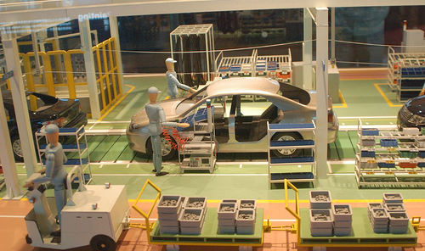

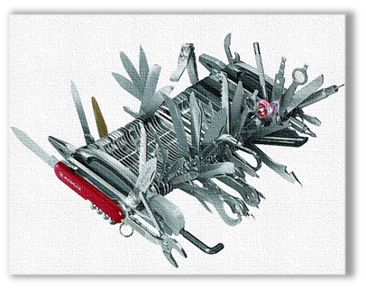
Single Responsibility Principle (SRP)
“There should never be more than one reason for a class to change.”
Each responsibility should be a separate class, because each responsibility is an axis of change.
A class should have one, and only one, reason to change.
If a change to the business rules causes a class to change, then a change to the database schema, GUI, report format, or any other segment of the system should not force that class to change.
Robots on an assembly line are streamlined for the individual tasks they preform. This makes maintaining, upgrading, and replacing them easier and less expensive.
• Axis of Change
• Separation of Concern
• Test-Driven Development (TDD)
• Logical Separation of Namespaces And Assemblies.

Slide 6
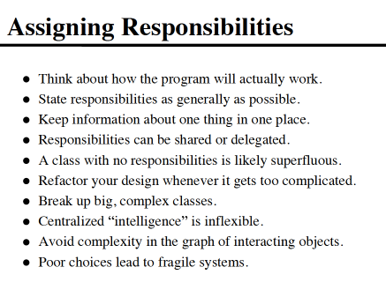
Single Responsibility Principle (SRP)

Slide 7
OCP the “O” in S.O.L.I.D

Slide 8
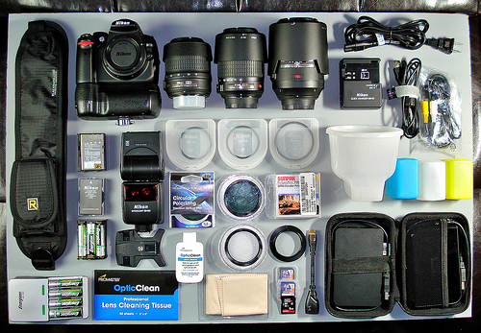
Open/Closed Principle (OCP)
« software entities (classes, modules, functions, etc.) should be open for extension, but closed for modification.”
-Bertrand Meyer
Objects should be design in such a way that it is easy to extend them without modifying them.
You can easily change the lens of most SLR cameras without having to saw off the old lens and weld on a new one. You can add filters to most SLR camera lens by just screwing them on.
• Meyer's Open/Closed Principle
Implementation of a class should only be modified to correct errors.
Changes or new features require that a different class be created (Interfaces)
• Polymorphic Open/Closed Principle
All member variables should be private.
Global variables should be avoided.

Slide 9
Change Happens
“All systems change during their life cycles. This must be borne in mind when developing systems expected to last longer than the first version.”
- Ivar Jacobson

Slide 10

All member variables should be private
Instead of Public Fields
Use Properties or Properties with Private Backing Fields

Slide 11
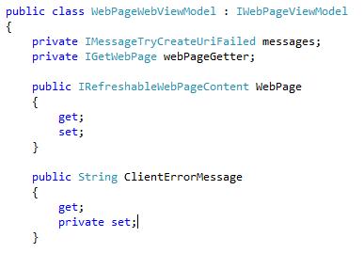
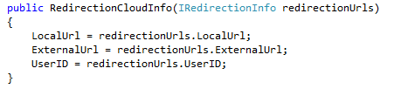
Method parameters should be interfaces not specific classes
Using interfaces for parameters, properties, and variables whenever
possible helps keep them “Open” to extension and also helps
keep the classes “Closed” to modification because the abstraction.

Slide 12
LSP the “L” in S.O.L.I.D

Slide 13

Liskov Substitution Principle (LSP)
“Objects in a program should be replaceable with instances of their subtypes without altering the correctness of that program”
“Functions that use pointers or references to base classes must be able to use objects of derived classes without knowing it.”
As you extend objects the original functionality of the elements that makeup the object should not change.
Any Base 10 calculator should produce a result of “4” when you press “2+2=“ regardless of the age or sophistication of the device. The original functionality of objects should preserved as you build on them.
• Polymorphism
• Test-Driven Development (TDD)
• Avoid Run-Time Type Information (RTTI)

Slide 14
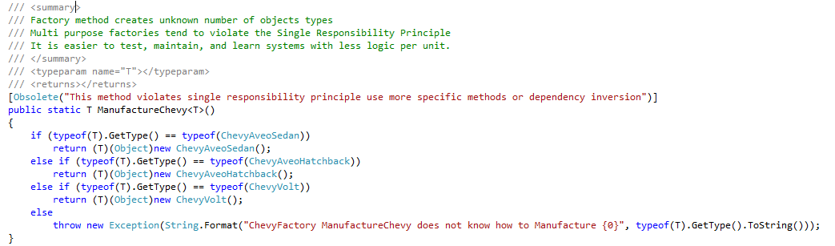

Avoid Run-Time Type Information (RTTI)
Sometimes using RTTI is unavoidable

Slide 15
ISP the “I” in S.O.L.I.D

Slide 16
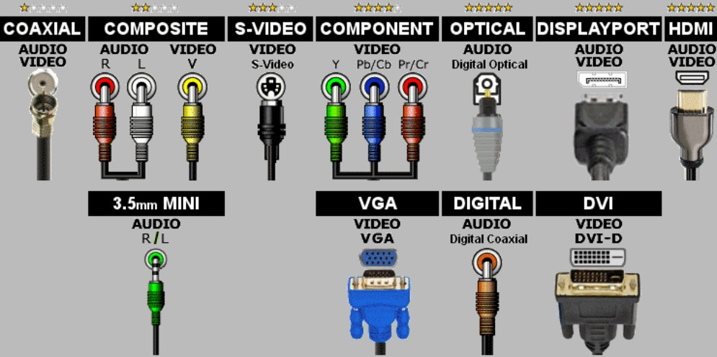
Interface Segregation Principle (ISP)
“Many client specific interfaces are better than one general purpose interface”
“Clients should not be forced to depend upon interfaces that they do not use.”
It is difficult to use a device that produces “HDMI Audio/Video” with a “Digital Optical” sound player.
• Design by contract (DbC) / Design to Interfaces
• Test-Driven Development (TDD)

Slide 17
Abstract classes using interfaces
Use interfaces. Even where you don't need them yet.
Steve Rowe
http://blogs.msdn.com/b/steverowe/archive/2008/01/21/design-to-interfaces.aspx

Slide 18
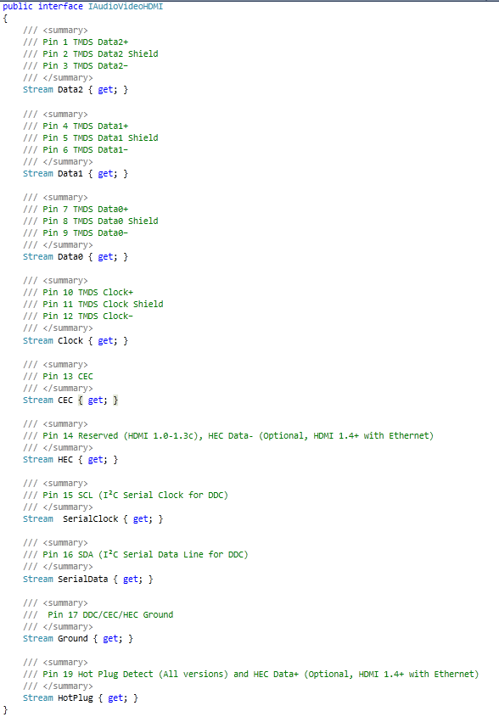

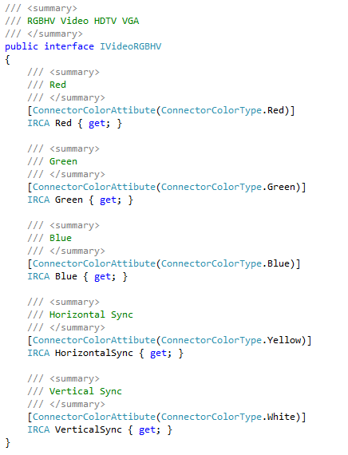
Many specific interfaces are better one general

Slide 19



Clients should not depend upon interfaces that they do not use
Each interface should specifically describe only
what is needed and nothing more.

Slide 20
DIP the “D” in S.O.L.I.D

Slide 21
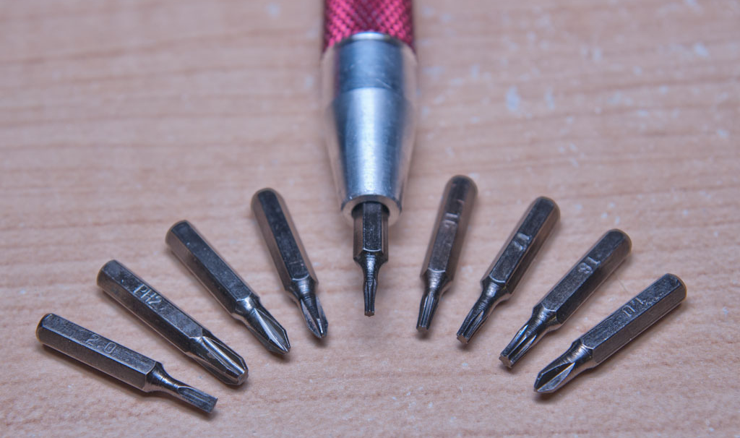
Dependency Inversion Principle (DIP)
“High level modules should not depend upon low level modules. Both should depend upon abstractions.”
“Abstractions should not depend upon details. Details should depend upon abstractions.”
Screwdriver bits do not care what brand or type of Slotted Screwdriver they are used with.
• Loose Coupling
• Dependency Injection / Inversion of Control

Slide 22
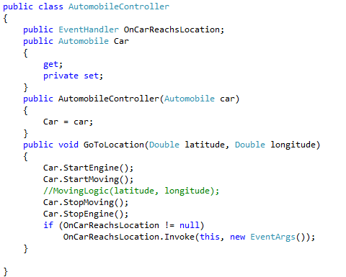
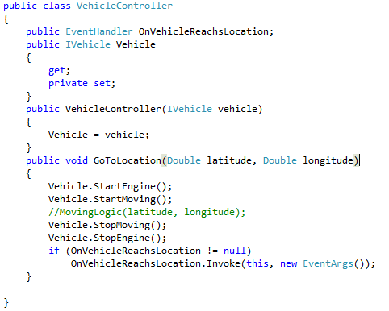
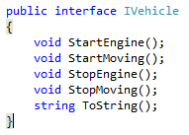
Dependency Injection / Inversion of Control

Slide 23
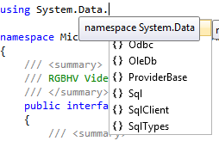
High & low level modules should depend upon abstractions
No reference or dependency to a specific Data access technology should
ever exist outside of the Data Access Assembly.
Only Interfaces and POJO (Plain Old Java Objects) should be referenced
between assemblies and primarily they should reference an interface.

Slide 24
S.O.L.I.D Principles of Software Development

Slide 25
S.O.L.I.D Principles of Software Development
The first sprint that involves actual programming should be a single vertical slice that demonstrates scope and strategy of the entire application from top to bottom.

